Slide 1



The status of Energy Poverty in Europe
Eleni Kanellou, National Technical University of Athens
21st of June 2023
This project has received funding from the European Union's HORIZON 2020 research and innovation programme under grant agreement No 890437

Slide 2


Energy poverty
Concept
Energy poverty is often understood “as a situation where a household cannot meet its domestic energy needs”⁽¹⁾
Electricity
Heating
Cooling
Cooking
“Adequate warmth, cooling, lighting and the energy to power appliances are essential services needed to guarantee a decent standard of living and citizens’ health.”
EU Energy Poverty Observatory, 2018
(www.energypoverty.eu)
www.powerpoor.eu
EU Energy Poverty Observatory, 2020 / Picture credits: freepik.com
Notes:
Living in inadequately heated or cooled households negatively impacts human health and well-being. In addition, individuals who are unable to meet their basic energy needs are prevented from fully participating in society.

Slide 3
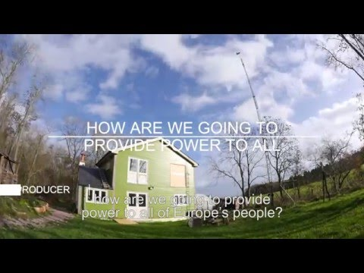

Understanding Energy Poverty
Energy Poverty in Europe – A complex challenge
Source: Energy Poverty in the European Union, YouTube: https://youtu.be/kT-lpCdd_WI
www.powerpoor.eu
Notes:
This video explains the concept of energy poverty, its causes and how they can be addressed in Europe.

Slide 4
Energy poverty
Energy Poverty in the Global Sustainability Agenda
Paris Agreement Country NDCs
SDG 7
Sustainable Energy Platforms (SE4All)
Global Covenant of Mayors
The energy crisis
COVID-19 Pandemic
www.powerpoor.eu

Slide 5
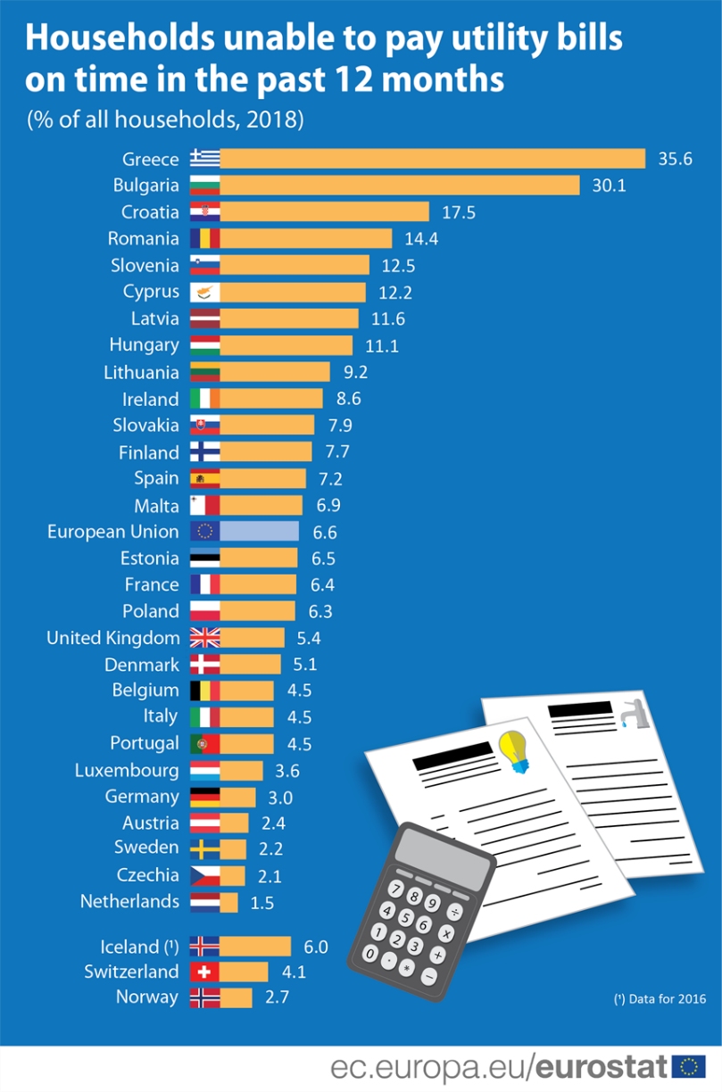
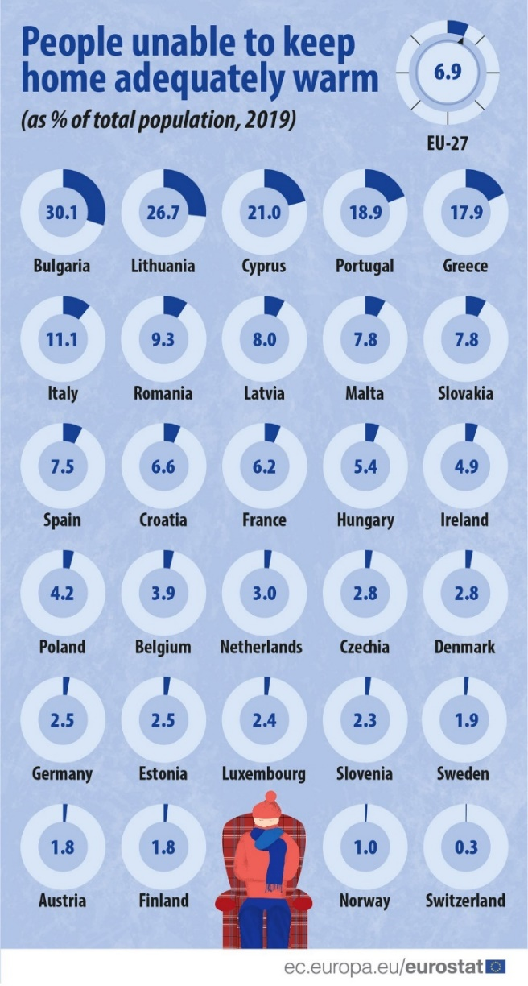
Energy poverty facts in Europe
People unable to pay utility bills on time and keep their homes warm
www.powerpoor.eu

Slide 6
Energy poverty policy framework in Europe
Setting the pathway for accelerated action
EU Energy Poverty Observatory
Energy Poverty Advisory Hub
Mitigating Household Energy Poverty – H2020 Call
CoM Third Pillar (Energy Poverty)
EU Clean Energy for all Europeans' package
European Green Deal
Renovation Wave
  Energy poverty is addressed in different European policy instruments and initiatives.
www.powerpoor.eu

Slide 7
Energy poverty policy framework in Europe
Legal framework at EU level
Electricity directive 2019/944
  Requiring member states to take appropriate measures to address energy poverty and support vulnerable consumers
Governance Regulation (1999/999)
  Member States must include in their National Energy and Climate Plans (2020-2030) an indicative objective to reduce energy poverty, provide a time frame, and outline relevant policies
Fit for 55 package and the Recast Energy Efficiency Directive (EED) – political agreement March 2023:
  EU-wide definition of energy poverty, Obligation on MS to prioritise energy efficiency measures among vulnerable customers and energy poor
www.powerpoor.eu
Notes:
Article 2(49): ‘energy poverty’ means a household’s lack of access to essential energy services that underpin a decent standard of living and health, including adequate warmth, cooling, lighting, and energy to power appliances, in the relevant national context, existing social policy and other relevant policies.
Obligation to assess number of households in energy poverty, and must establish and publish the criteria underpinning this assessment. (Art 29)
There is no standard definition of energy poverty - Member States need to develop their own criteria according to their national context.

Slide 8
Energy poverty policy framework in Europe
Legal framework at EU level
Social Climate Fund
  Target group are households, micro-enterprises and transport users, which are vulnerable and particularly affected by the inclusion of greenhouse gas emissions from buildings and road transport
Recast Energy Performance of Buildings (EBPD)
  Prioritising renovation investments for energy poor and vulnerable households
Proposal for electricity market design (adopted 14/03)
  Including proposals to strengthen consumer empowerment, including on energy sharing, and proposing ban of disconnection of all vulnerable households
www.powerpoor.eu

Slide 9
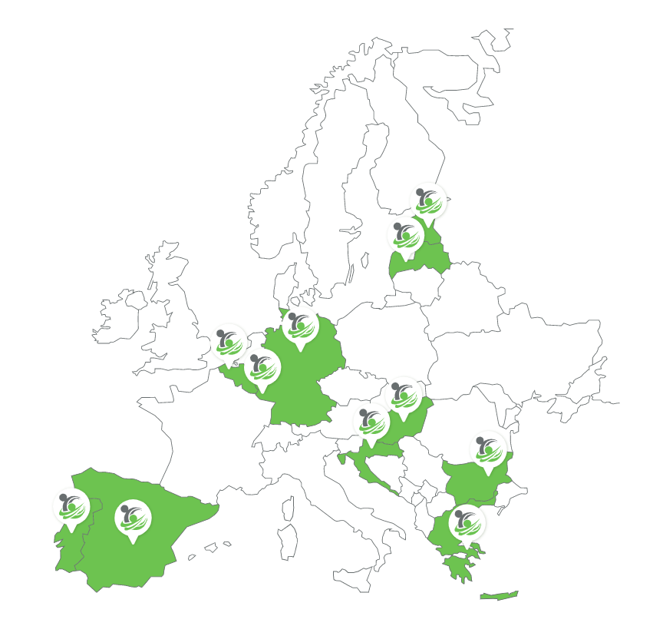














The POWERPOOR consortium
14 participating partners – 11 countries - 8 pilot countries
www.powerpoor.eu

Slide 10
POWERPOOR leads the way in
Supporting energy poor citizens to implement energy efficiency interventions and participate in joint energy initiatives, through the development of the POWERPOOR support programmes and tools, with the aim to alleviate energy poverty.
Facilitating behavioural change in energy usage and enabling the uptake of energy efficiency measures through experience and knowledge sharing, as well as through joint energy initiatives and citizen engagement campaigns targeting groups of consumers in energy poor communities.
Promoting energy community projects / alternative financing schemes and assisting citizens to pursue funding opportunities (e.g., energy communities, energy cooperatives
& crowdfunding).
Energy poverty alleviation support
schemes
will be designed, developed and implemented in 8 pilot countries across Europe, led by a network of certified Energy Supporters and Energy Mentors.
Through energy poverty alleviation support
schemes
citizens are positioned at the heart of the solution through a gradual transition from
an energy poor citizen towards an informed consumer and later an active prosumer.
www.powerpoor.eu

Slide 11




Energy Poverty Mitigation Toolkit
POWER - TARGET
POWER –
ACT
POWER - FUND
Energy poverty Guidebook
Identify citizens suffering from energy poverty
Enable them to understand their energy use
Communicate innovative financing
Incorporate energy poverty mitigation actions into SECAPS
Module 1 - ENPOV
Module 2 - ACTIONS
Module 3 - FUND
Module 4 - PLAN
Training material
The toolkit can be utilised by citizens suffering from energy poverty, public and national authorities, energy communities or cooperatives, experts in the field, or other stakeholders
www.powerpoor.eu
Notes:
The developed toolkit contains 3 tools and a guidebook of how to incorporate energy poverty into local energy planning.
POWER TARGET aims at using a data driven approach to identify citizens and households suffering from energy poverty.
POWER ACT enables those who suffer from the phenomenon to understand their energy usage and proposes to them behaviour changes and small-scale interventions to enhance their position.
The POWER FUND tool will enable them to have access to innovative financing schemes and joint energy initiatives to lower their energy usage and expenses as well as fund large scale interventions if necessary.
How to use the three tools will be explained further in a later stage.

Slide 12

Energy poverty support programmes
In each pilot country, energy poor households and citizens are identified, leveraging the knowledge of the local partners (POWER-TARGET).
Energy support programmes are developed by a certified network of Energy Supporters, who provide energy poor citizens :
(a) Tips and information to encourage behaviour change and/or small-scale interventions (POWER-ACT), in addition to
(b) Information on how to take part in innovative financing schemes such as energy communities, cooperatives and crowdfunding campaigns to fund interventions that can alleviate the problem (POWER-FUND).
Local Energy Poverty Alleviation Offices have been established in the participating municipalities, run by a certified network of Energy Mentors
Energy Supporters directly engage with energy-poor citizens and assist them in planning, securing funding and implementing energy efficiency interventions.
Energy Mentors provide support and expertise in all the key areas associated to the operation and/or creation of an energy community / cooperative of energy poor citizens.
www.powerpoor.eu
Notes:
So how the POWERPOR approach works.
Initially in each pilot country households and citizens suffering from the phenomenon will be identified, by a certified and trained network of Energy Supporters and Mentors.
After the citizens have been identified they will be enabled to lower their energy bills and increase their energy efficiency through suggestions from the POWER ACT tool.
Then they will also be able to use innovative financing schemes and joint energy initiatives to further mitigate the phenomenon as well as to fund large scale interventions if needed.
At the same time in a community level Local Energy Poverty Alleviation Offices will be established to further assist people as well as to incorporate the phenomenon in the local energy planning.
To this point is should be mentioned that Energy Supporters will be trained to directly engage citizens suffering from energy poverty to assist them in understanding their energy expenses, implement behavioural changes to lower the expences and enhance their energy efficiency and plan interventions which can be funded through innovative financing schemes and joint energy initiatives.
Energy mentors focus more on the community side, and they will guide citizens on how to create and operate energy communities or cooperatives and how to incorporate energy poverty alleviation strategies in local energy planning.

Slide 13
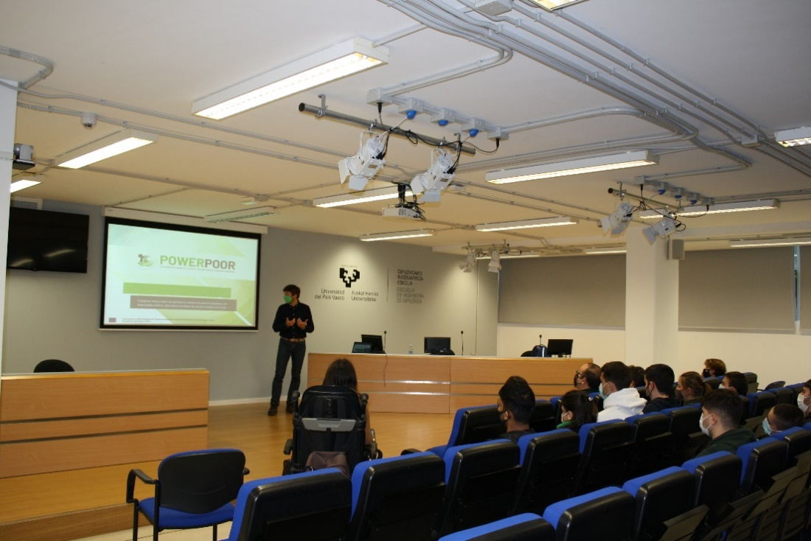

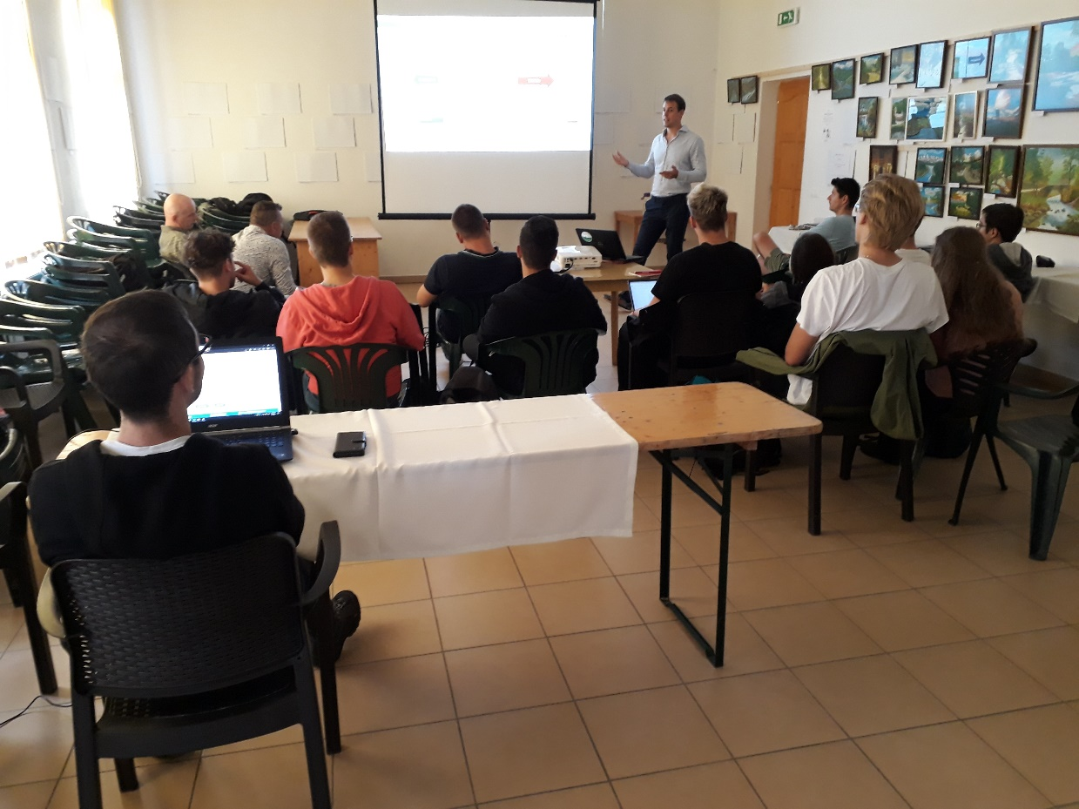

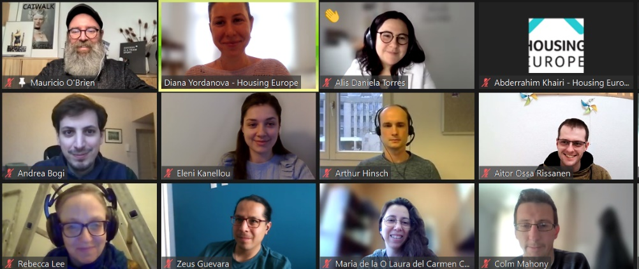
Training Seminars
www.powerpoor.eu

Slide 14
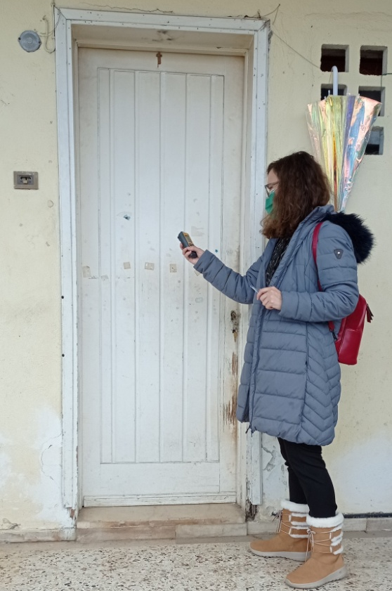
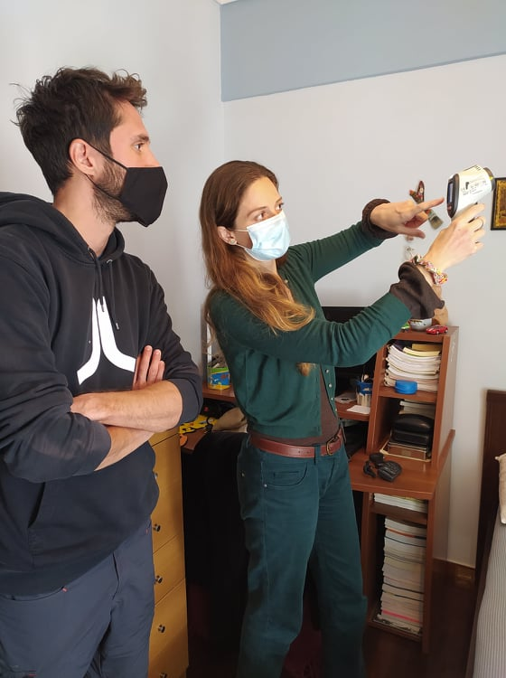
Energy Supporters and Mentors in action
www.powerpoor.eu

Slide 15
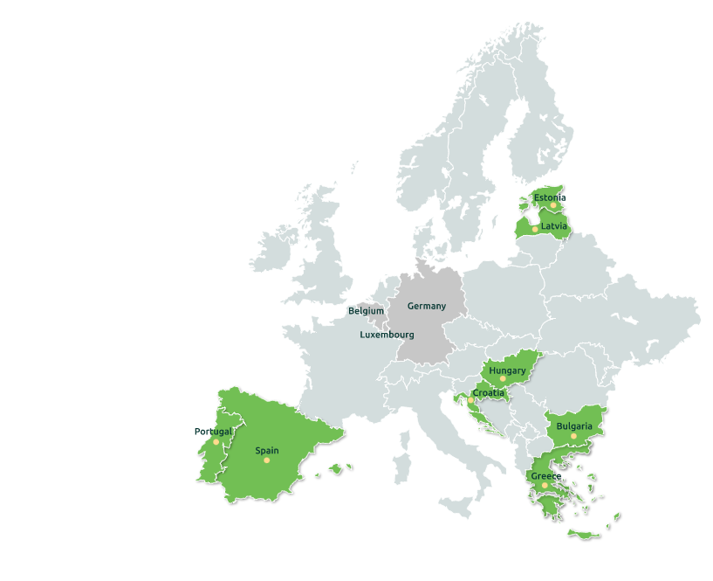
The Energy Poverty Alleviation Offices
Tallinn
Jelgava
Józsefváros
Terézváros
Zagreb
Križevci
Ermesinde
Mértola
Lisbon
Sofia
Plovdiv
Messini
Souli
Almyros
Tripoli
Aspropyrgos
WeEnCoop Thessaloniki
Tolosaldea region
REC Hernani
Tierra Estella
Oarsoaldea region
Bergara
www.powerpoor.eu

Slide 16
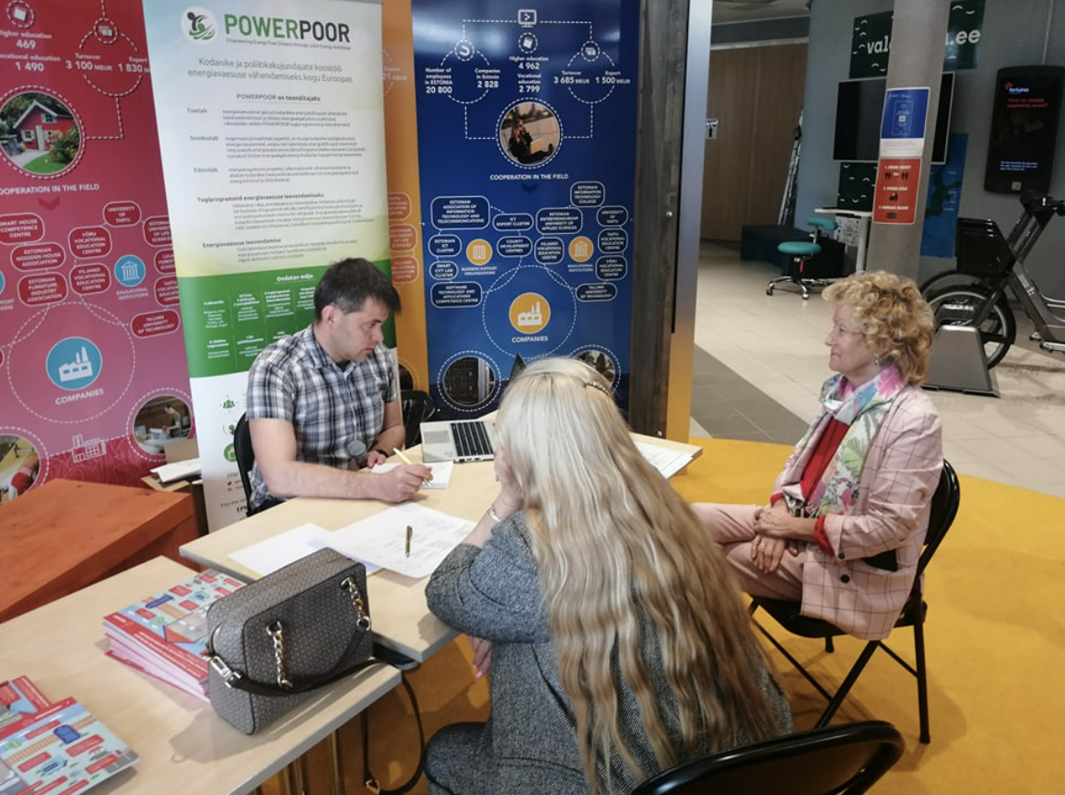
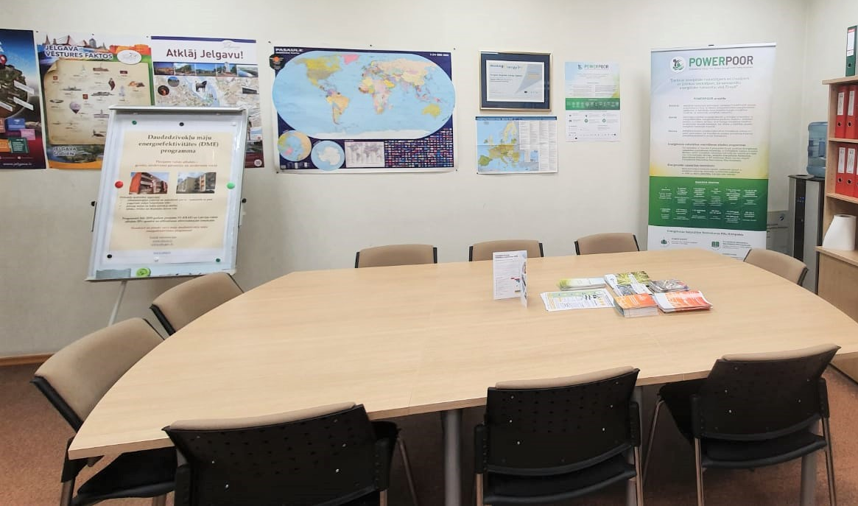
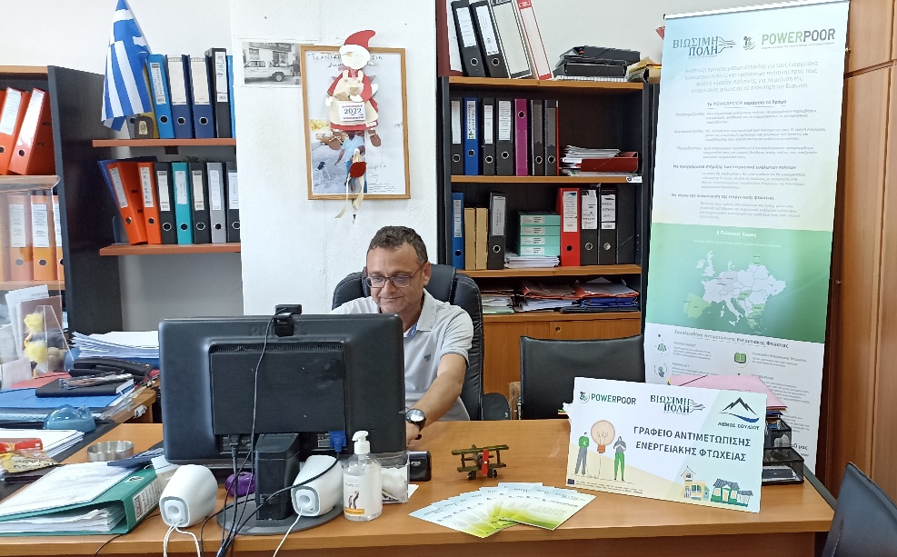
Energy Poverty Alleviation Offices
Estonia
Latvia
Greece
www.powerpoor.eu

Slide 17
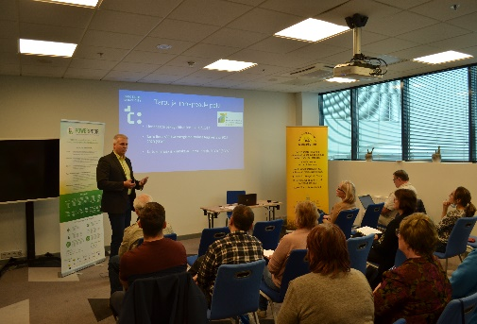
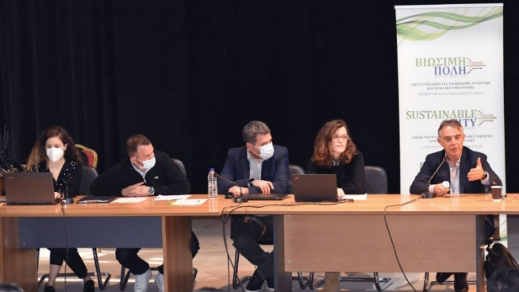
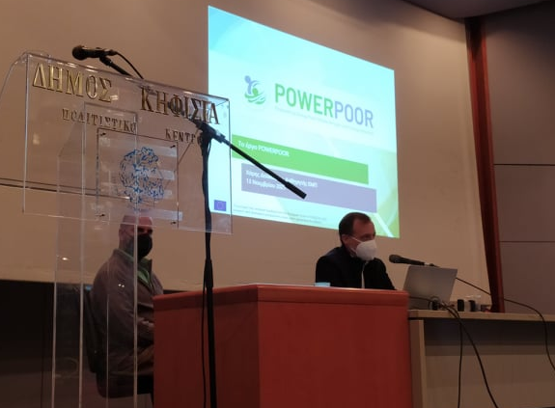
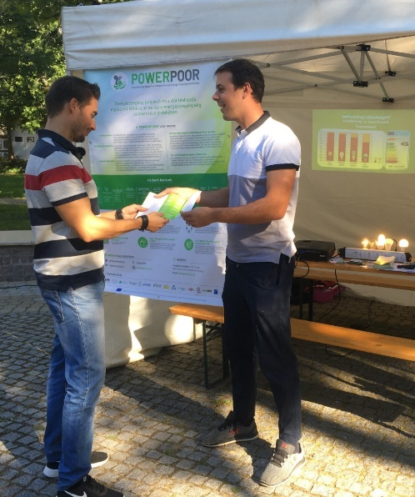
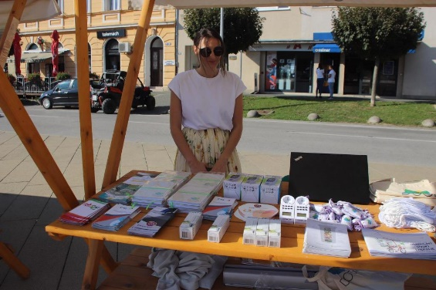
Info days
Estonia
Greece
Hungary
Croatia
www.powerpoor.eu

Slide 18
In a nutshell
More than 1,600 people have attended the 59 training seminars across EU
More than 1,100 people became certified Energy Supporters and Mentors
3000 interactions in the tools
Support of about 15,000 households in 52 municipalities, 22 of which have also established an Energy Poverty Alleviation Office
More than 4,000 home visits in energy poor households
25 info days with more than 1,200 attendees
Presentations in 58 events with 30.000 attendees across Europe
8 policy national roadmaps and EU policy recommendations
www.powerpoor.eu
Notes:
The POWERPOOR results are ambitious and on the right path to alleviate the phenomenon.
In an EU level 1.100 Energy Supporters and Mentors are expected to be trained and certified.
At least 15 energy poverty alleviation offices will be set up and running.
8 national roadmaps and a European one aiming to alleviate energy poverty through policymaking will be developed.
The POWERPOOR Alliance network will be established to support the sustainability of the action and the sustainability of the project’s approach and results after its completion.

Slide 19

Thank you!
www.powerpoor.eu/
This project has received funding from the European Union's HORIZON 2020 research and innovation programme under grant agreement No 890437

