Slide 1


List of Certified Energy Supporters and Mentors
Within the POWERPOOR Consortium
This project has received funding from the European Union's HORIZON 2020 research and innovation programme under grant agreement No 890437

Slide 2

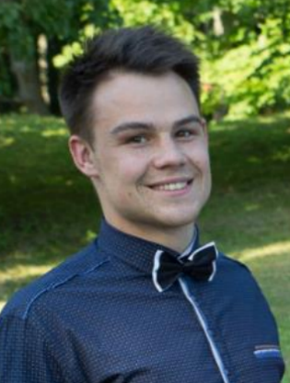
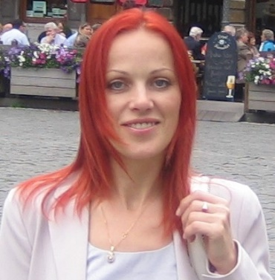

Latvia
  Ermanis Elvis, ZREA
  elvis@zrea.lv
  Kreicmane Inga, ZREA
  inga@zrea.lv
www.powerpoor.eu

Slide 3



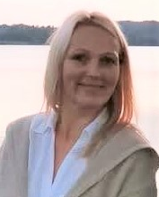
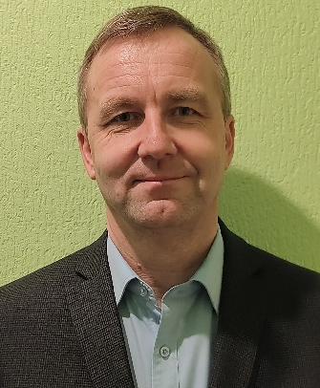
Auce county
  Aiga Kalnina, Auce utility services
  aucesprojekti@inbox.lv
  Ilmars Matvejs, Development Department of Auce municipality
  ilmars.matvejs@dome.auce.lv
www.powerpoor.eu

Slide 4

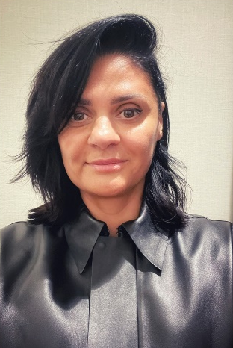

Jelgava
  Dace Dirzine, Jelgava Social services dace.dirzine@soc.jelgava.lv
  Kristine Staraste, Jelgava Real Estate managment
  kristine.kaze@inbox.lv
  Jelena Baranovska, Jelgava Real Estate managment
  elenabaranovska@inbox.lv
  Julija Zagorska, Jelgava Real Estate managment
  julija@jnip.lv
www.powerpoor.eu

Slide 5
Jekabpils
  Vita Kļaviņa, Jekabpils Real Estate managment
  vita.klavina@inbox.lv
  Inita Sietniece, Jekabpils Real Estate managment
  inita.sietniece@jknp.lv
  Guntars Jucītis, Jekabpils Real Estate managment
  project.assistant@housingeurope.eu
  Aigars Zīmelis, aigarszz@inbox.lv
www.powerpoor.eu

Slide 6
Jekabpils
  Natalja Lavrinovica, Social house duty officer natalja.lavrinovica@jekabpils.lv
www.powerpoor.eu

