Slide 1


List of Certified Energy Supporters and Mentors
Within the POWERPOOR Consortium
This project has received funding from the European Union's HORIZON 2020 research and innovation programme under grant agreement No 890437

Slide 2

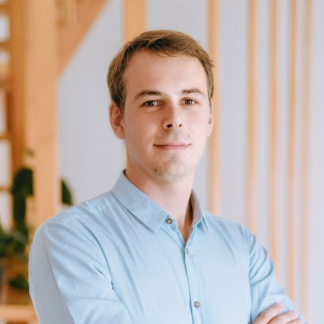
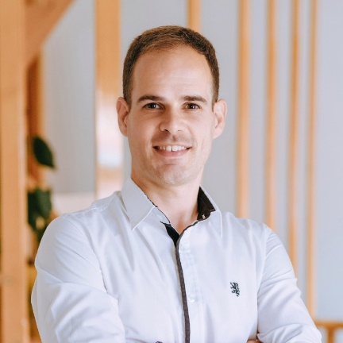
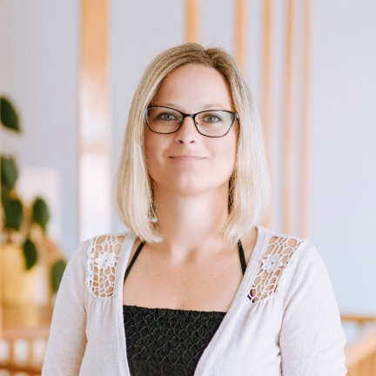


Hungary
  Csontos Csaba, Energiaklub
  csontos@energiaklub.hu
  László Magyar, Energiaklub
  magyar@energiaklub.hu
  Zsófia Pej, Energiaklub
  pej@energiaklub.hu
  Kata Győri, Energiaklub
  csontos@energiaklub.hu
www.powerpoor.eu

Slide 3
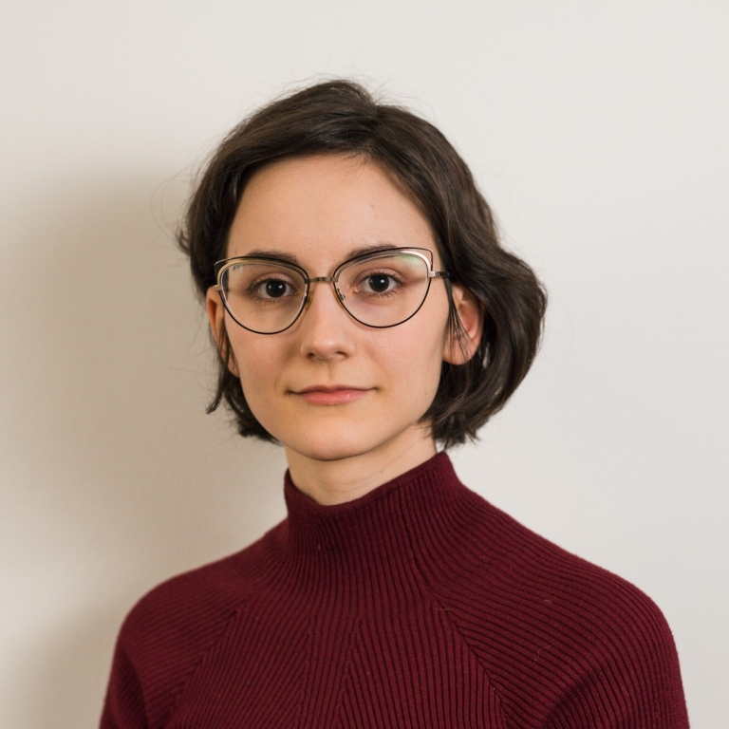
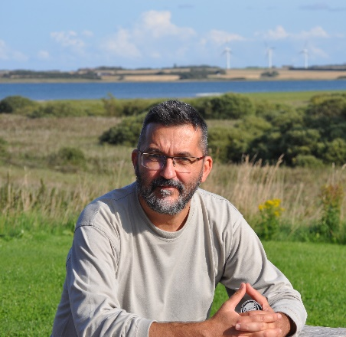
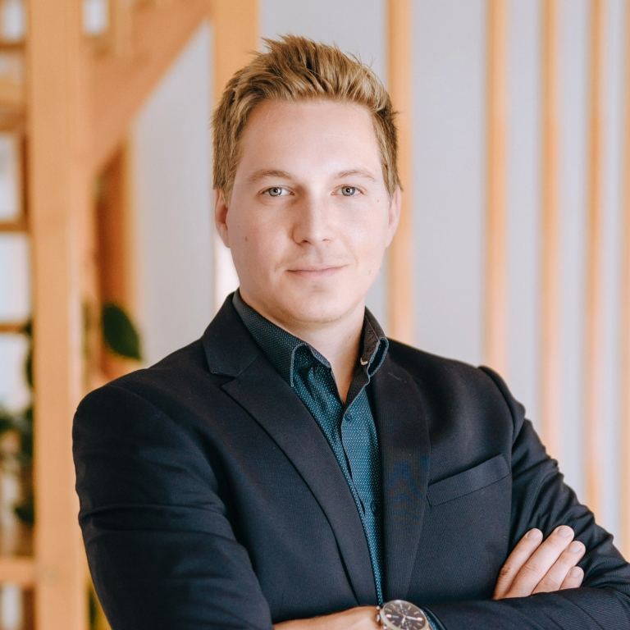
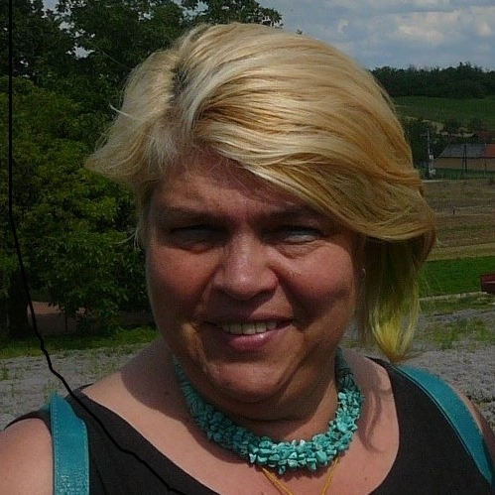
Hungary
  Nóra Horváth, Energiaklub
  horvath@energiaklub.hu
  Dr. Béla Munkácsy,
  Assistant Professor at
  ELTE University
  munkacsy@elte.hu
  Gergely Schum, Energiaklub
  schum@energiaklub.hu
  Györgyi Újszászi,
  Environmental officer at the 1st district of Budapest magyar@energiaklub.hu
www.powerpoor.eu

Slide 4
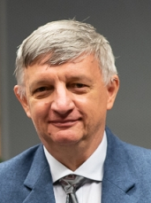

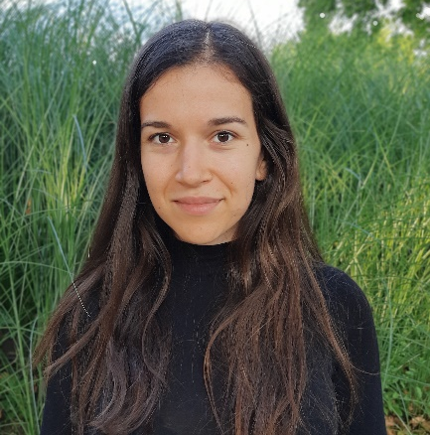
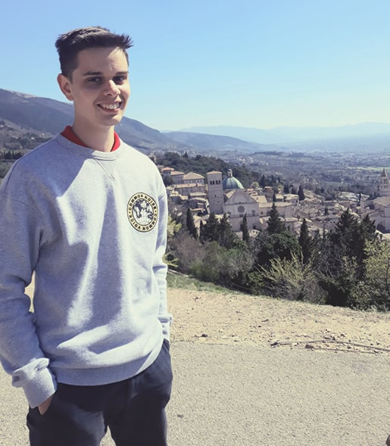
Hungary
  Róbert Hutyán,
  Entrepreneur
  sziriusz@gmail.com
  Bendegúz Pornói,
  MA student at ELTEUniversity (biology/geography teacher)
  Csilla Gyökeres,
  MA student at ELTEUniversity (biology/geography teacher)
  Gergely Vass,
  Student (BSc,Geography at ELTE University)
  gergovass23@gmail.com
www.powerpoor.eu

Slide 5
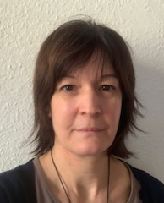
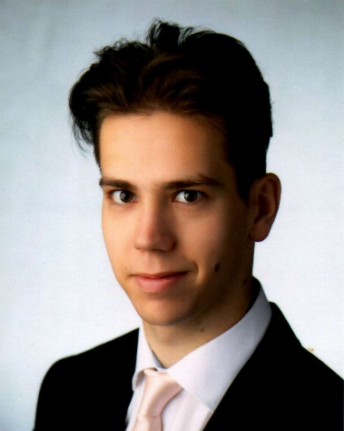

Hungary
  Dr. Zsófia Lennert, Environmental officer at the 8th district of Budapest (Józsefváros)
  zsofia.lennert@gmail.com
  Tihamér Kovács,
  Assistant at an energy
  supply system operator,
  tihamers@gmail.com
  Erik Suhajda,
  Student (BSc, Geography at ELTE University) ,
  suhierik@gmail.com
  Ábel Kovács,
  Student (BSc,Geography at ELTE University)
  kovacs.abel2001@gmail.com
www.powerpoor.eu

Slide 6
Hungary
  Gabriella Suba, Financial sector,
  g702582316@gmail.com
  Istvánné Tibor Süveg,
  Entrepreneur, suvegtiborne@gmail.com
  Mónika Hugyecz,
  Chief coordinator at the Directorate-General for Social Opportunities
  hugyecz.moncsi@gmail.com
  Zsolt Szilvási,
  Energy Advisor,
  szilvasi.zsolt@gmail.com
www.powerpoor.eu

Slide 7
Hungary
  Anna Mészégető,
  meszegetoanna@gmail.com
  György Thury,
  gy.thury@gmail.com
  Dóra Szász,
  Director
  doriszasz@gmail.com
  János Müllek,
  Facilities Engineer
  janos.mullek@gmail.com
www.powerpoor.eu

Slide 8
Hungary
  Martin Turai,
  Student (BSc,Geography at ELTE University)
  turaimartin01@citromail.hu
  Kinga Kalocsai,
  Architectural engineer, kalocsaikinga@hotmail.com
www.powerpoor.eu

